Slide 1

Uses of Data Structures

Slide 2

Presented by
1. Md. Maruf Sarker
2. Hasimunnahar Shanta
3. Md. Fartin Mahtadi Fuad
4. Md. Sirajul Arefin
Presented to
Babe Sultana
Assistant Professor & Lecturer Dept. of CSE
Green University Of Bangladesh

Slide 3
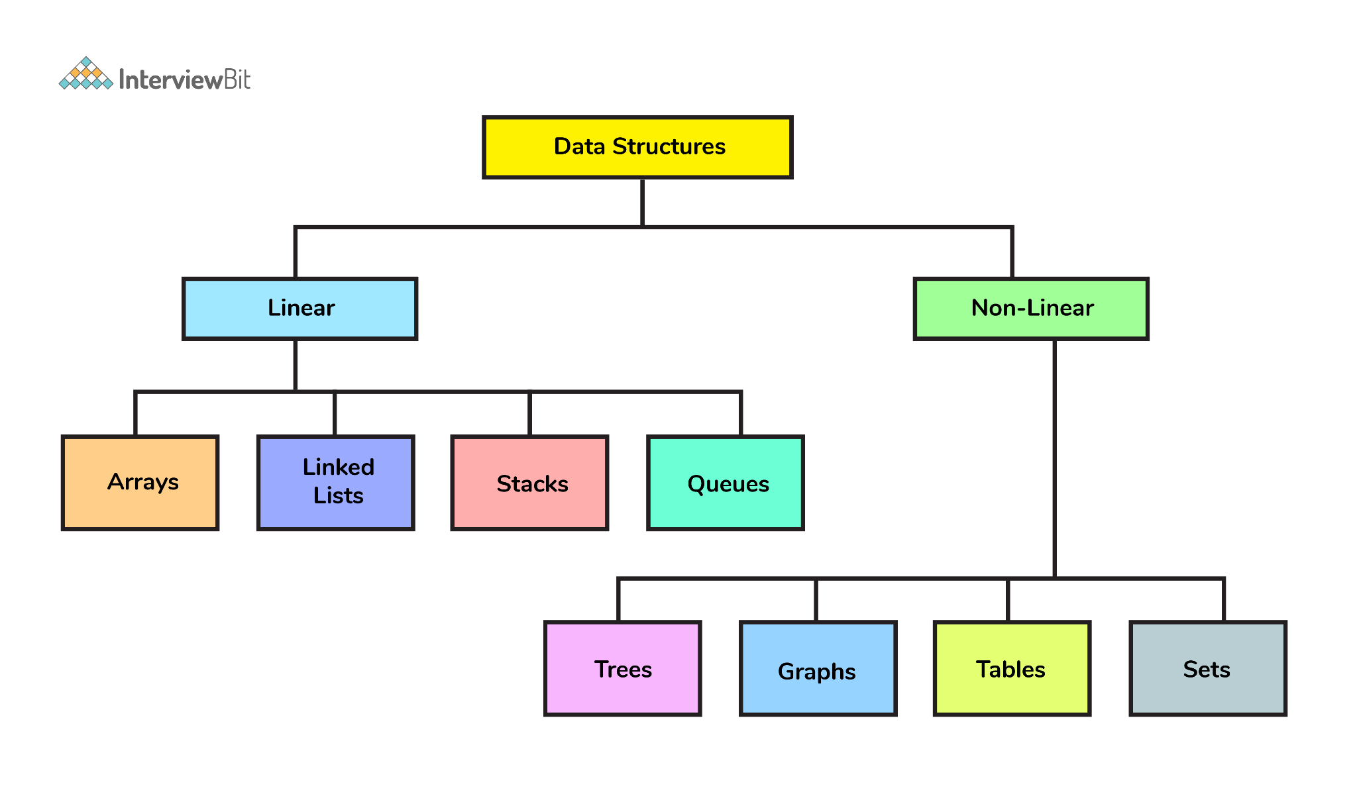

Slide 4
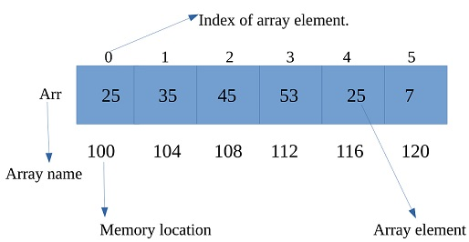
Array
An array is a linear data structure that collects elements of the same data type and stores them in contiguous and adjacent memory locations. Arrays work on an index system starting from 0 to (n-1), where n is the size of the array.

Slide 5
We can perform a lot of operations on the array data structure.
Display () – To Display the entire array on the screen.
Add(n) / Append(n) – To add a particular element on the end of the array.
Insert (index, n) – To add an element to a particular index.
Delete (index) – To delete an element with the help of an index in the given array.
Search (n) – To check whether the given element is present or not in an array.
Get (index) – It will return the element which presents on the given index.
Set (index, x) – It will change the element with the new element at a particular index.
Max () / Min () – These will return the max and min element in the given array.
Reverse () – It will reverse the order of elements in the given array.
Shift () – It will shift the whole elements either on the left or right side by the given number.

Slide 6
Applications of Array in Data Structure:
Arrays are used to implement vectors and lists which are an important part of C++ STL.
Arrays are also used to implement stack and queues.
Trees also use array implementation whenever possible as arrays are easy to handle compared to pointers. Tress, in turn, are used to implement various other types of data structures.
Matrices which are an important part of the mathematical library in any programming languages is implemented using arrays.
Adjacency list implementation of graph uses vectors which are again implemented using arrays.
Data structures like a heap, map, and set use binary search tree and balanced binary trees which uses can be implemented using arrays.
Arrays are used to maintain multiple variables with the same name.
CPU scheduling algorithms use implemented using arrays.
All sorting algorithms use arrays at its core.

Slide 7
Searching (Linear Search, Binary Search)
What is searching ?
linear
binary

Slide 8
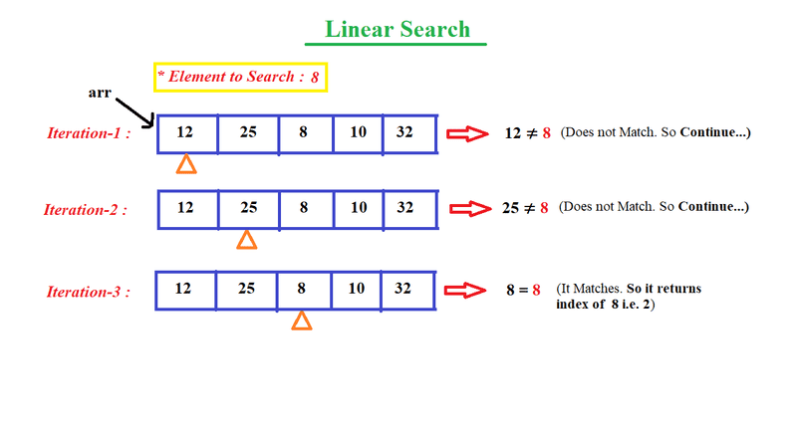
Time Complexity : O(n)
Space Complexity : O(1)

Slide 9
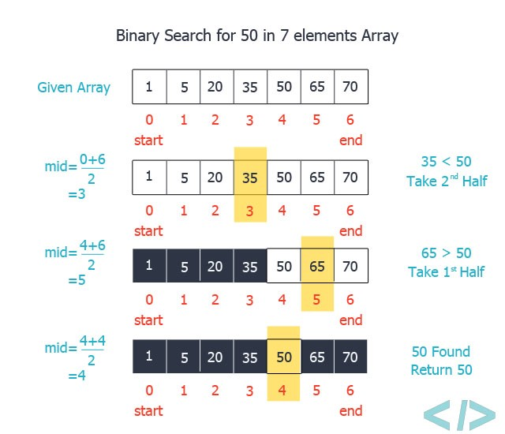
Time Complexity : O(log n)
Space Complexity : O(1)

Slide 10
Application of searching
Everyone who uses smartphone or computer, come across the operation of finding ( find in MS word) or searching.
Whether its a shopping websites like amazon, flipkart etc we search the product. Even in phone book we search the contact numbers,
Any searching operation you come across anywhere,involve either linear search or binary search.
My sequential search can display the last page of a 89MB fine in 8 seconds. 2million plus lines read twice..
It reads the file once counting the number of lines then reads it a 2nd time with the display starting 30 or so lines from the end of the file.
When adding notes to the end of a sequential file it is almost instantaneous
Sequential lends itself to Random.. Without random you have nothing.

Slide 11

Stack
Topic brief :
What is stack.
Working method of stack.
Application of stack.

Slide 12
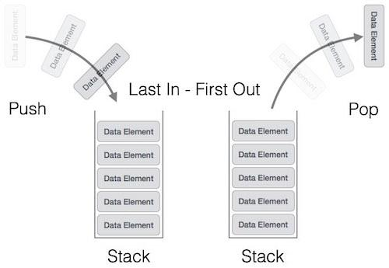
What is stack?
A linear type of data structure that allows insertion and deletion following the LIFO principle.

Slide 13
Working method of stack
STACK
Insertion ( )
Peek ( )
Deletion ( )
Overflow ( )
Underflow ( )
Used functions :
1. Insertion ( ) or, Push ( ) : To insert an element in stack.
2. Deletion ( ) or, Pop ( ) : To delete an element from stack.
3. Peek ( ) : To display the element on top position .
4.Overflow ( ) : Checks if stack is full.
5. Underflow ( ) : Checks if stack is empty.

Slide 14
Application of stack
Link 5
Link 4
Link 3
Link 2
Link 1
STACK
STAC
STA
ST
S
Forward
Backward
Redo
Undo
Browser history
Text editor/Typing
Other uses :
i. Backtracking.
ii. Expression evaluation etc.

Slide 15
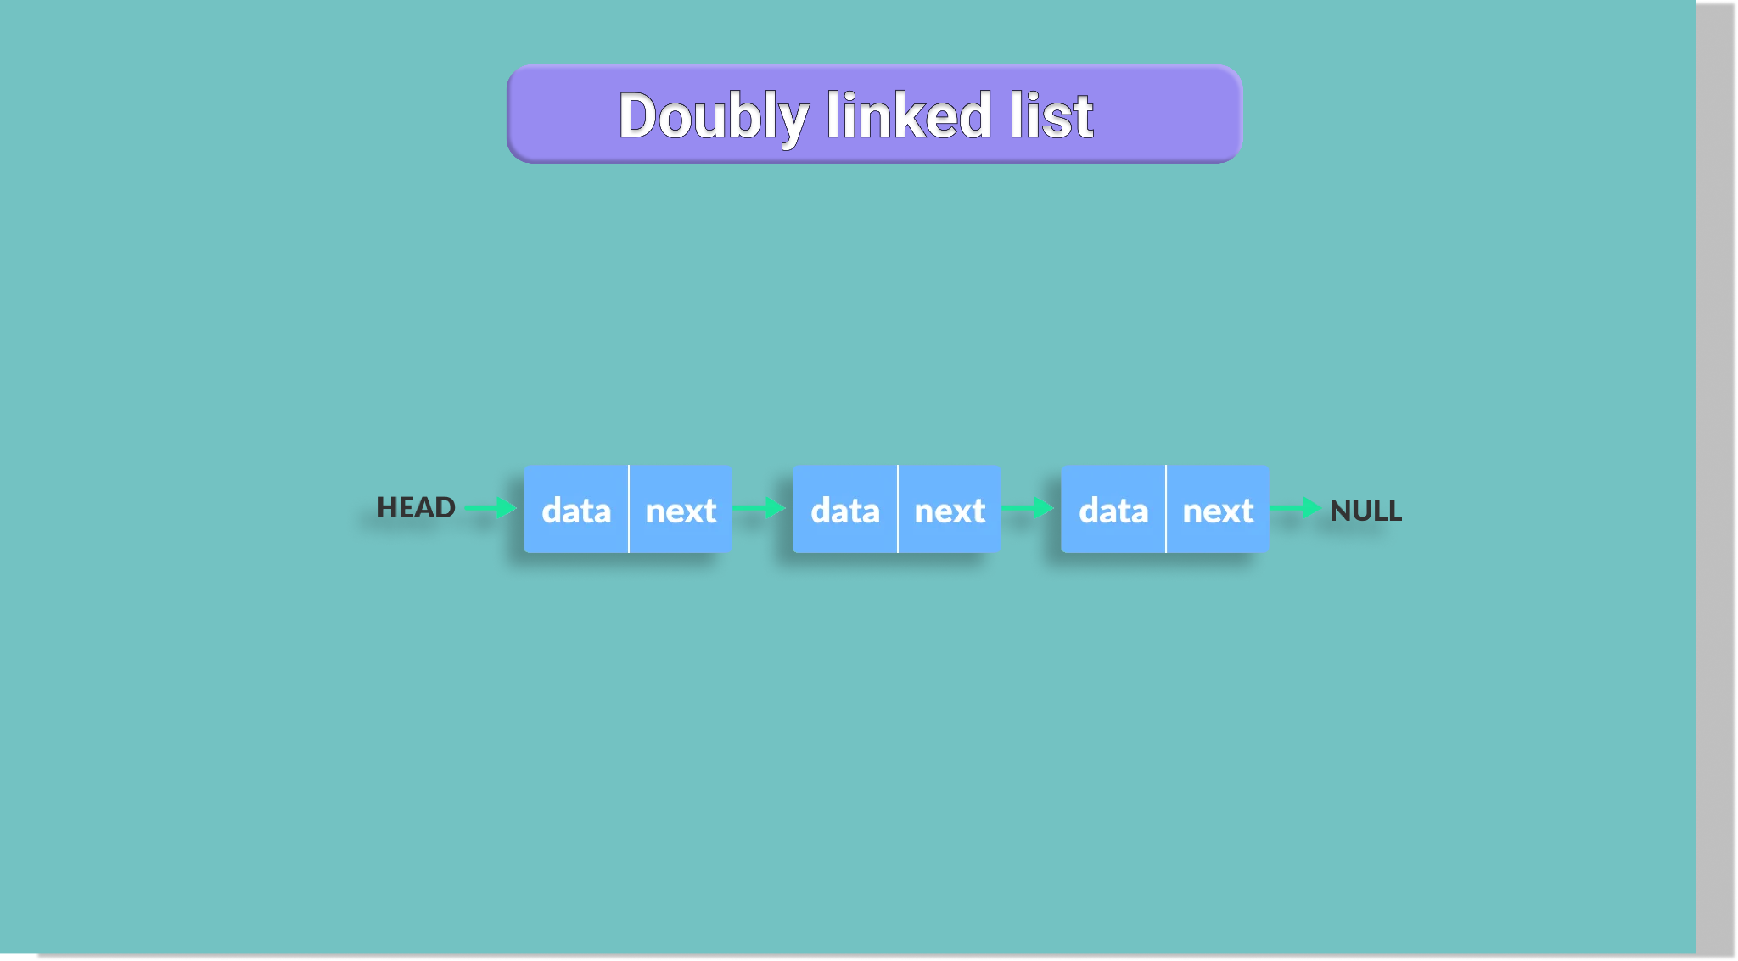

Slide 16
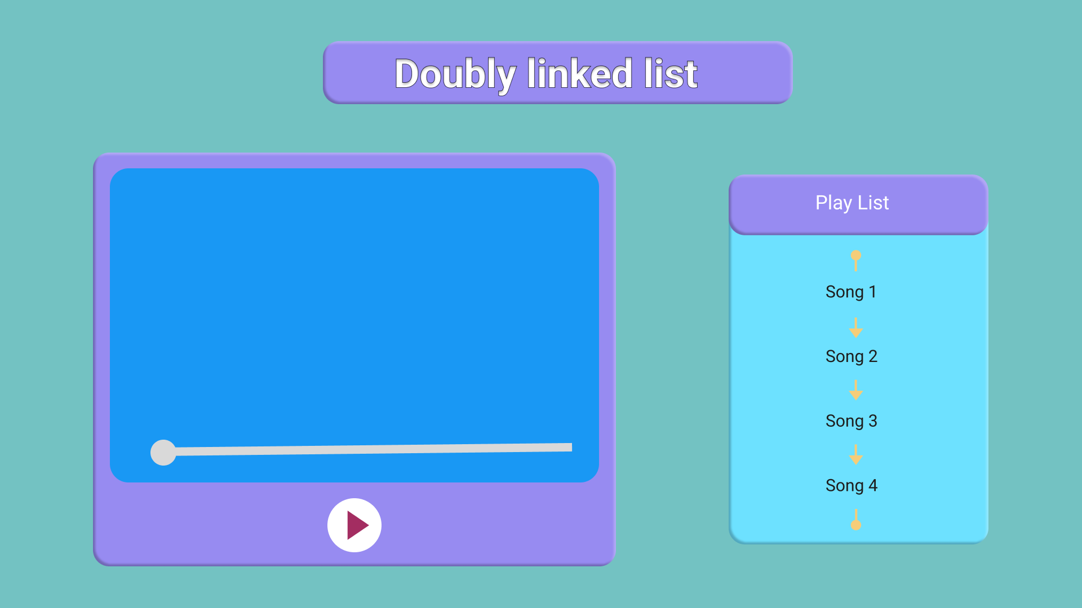





Slide 17
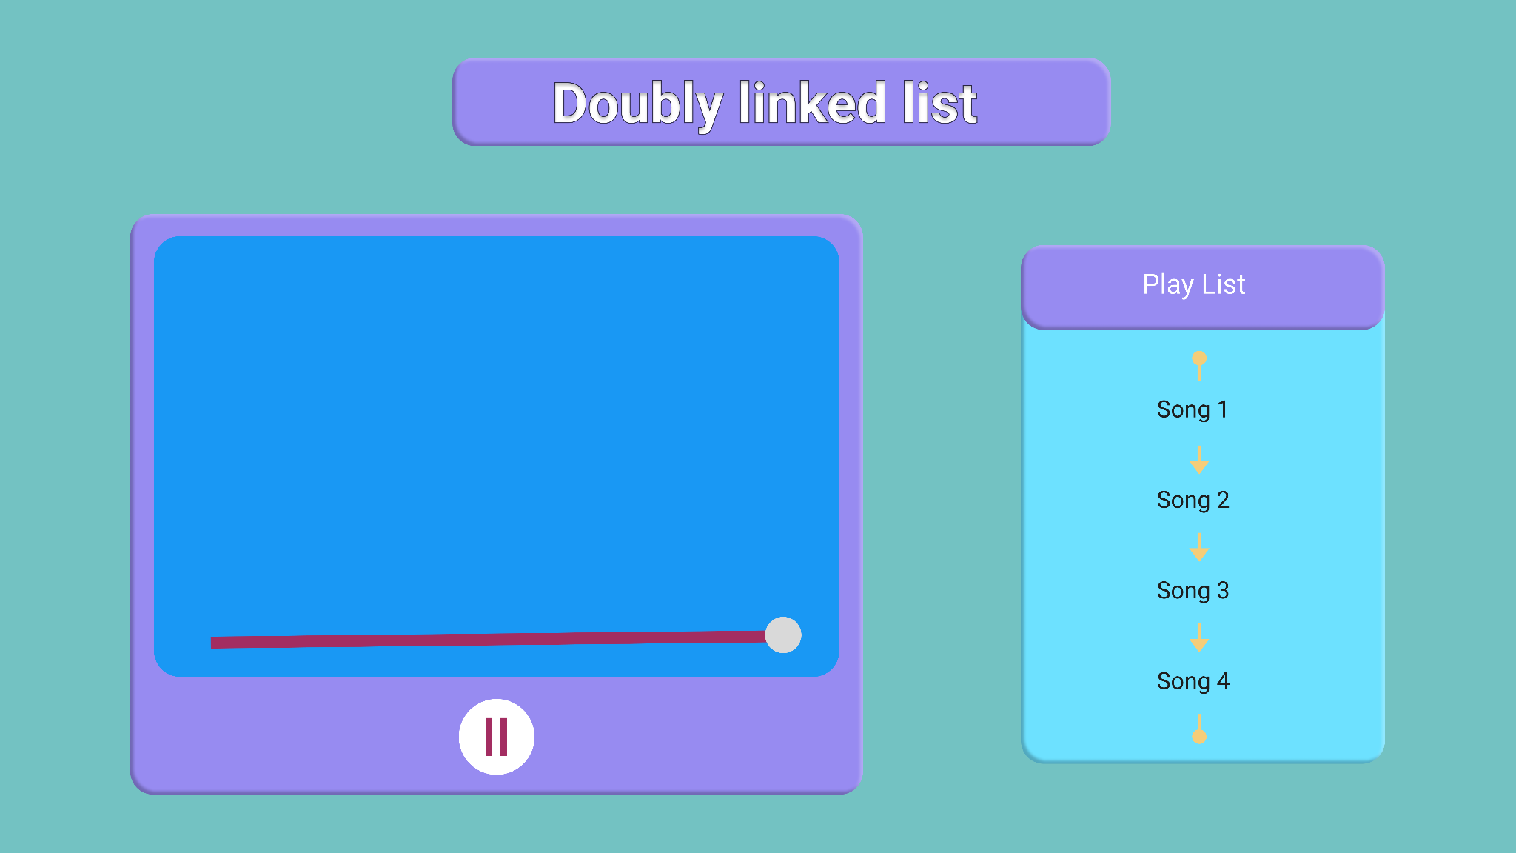




Slide 18


Slide 22
